Slide 1
M Twagirumukiza, LM Van Bortel
Heymans Institute of Pharmacology
Ghent University, Belgium
ARTERIAL STIFFNESS
AND CARDIOVASCULAR OUTCOMES: GLOBAL OVERVIEW AND IMPLICATION FOR AFRICA

Slide 2
Racial hypertension caracteristics
        YES ! There are hypertension patterns disparities between black and whites ( many studies in USA)
        African-American men have a greater prevalence of hypertension compared with their white American counterparts as their second decade of life.
        Fields LE et al, Hypertension 2004
        Hajjar I et al, JAMA 2003.
        African-American men develop high blood pressure (BP) sooner, and this may manifest as early
        Fields LE et al, Hypertension 2004
        No! Mecanisms and explanations are known

Slide 3
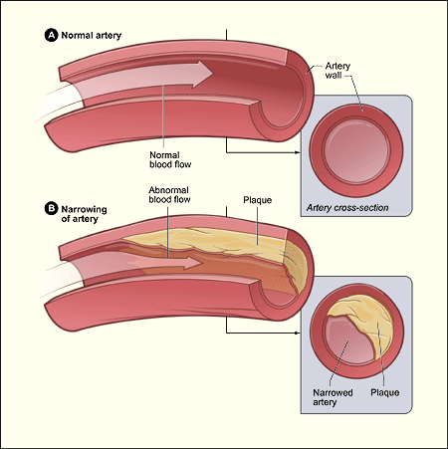
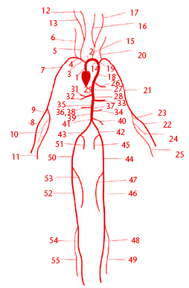
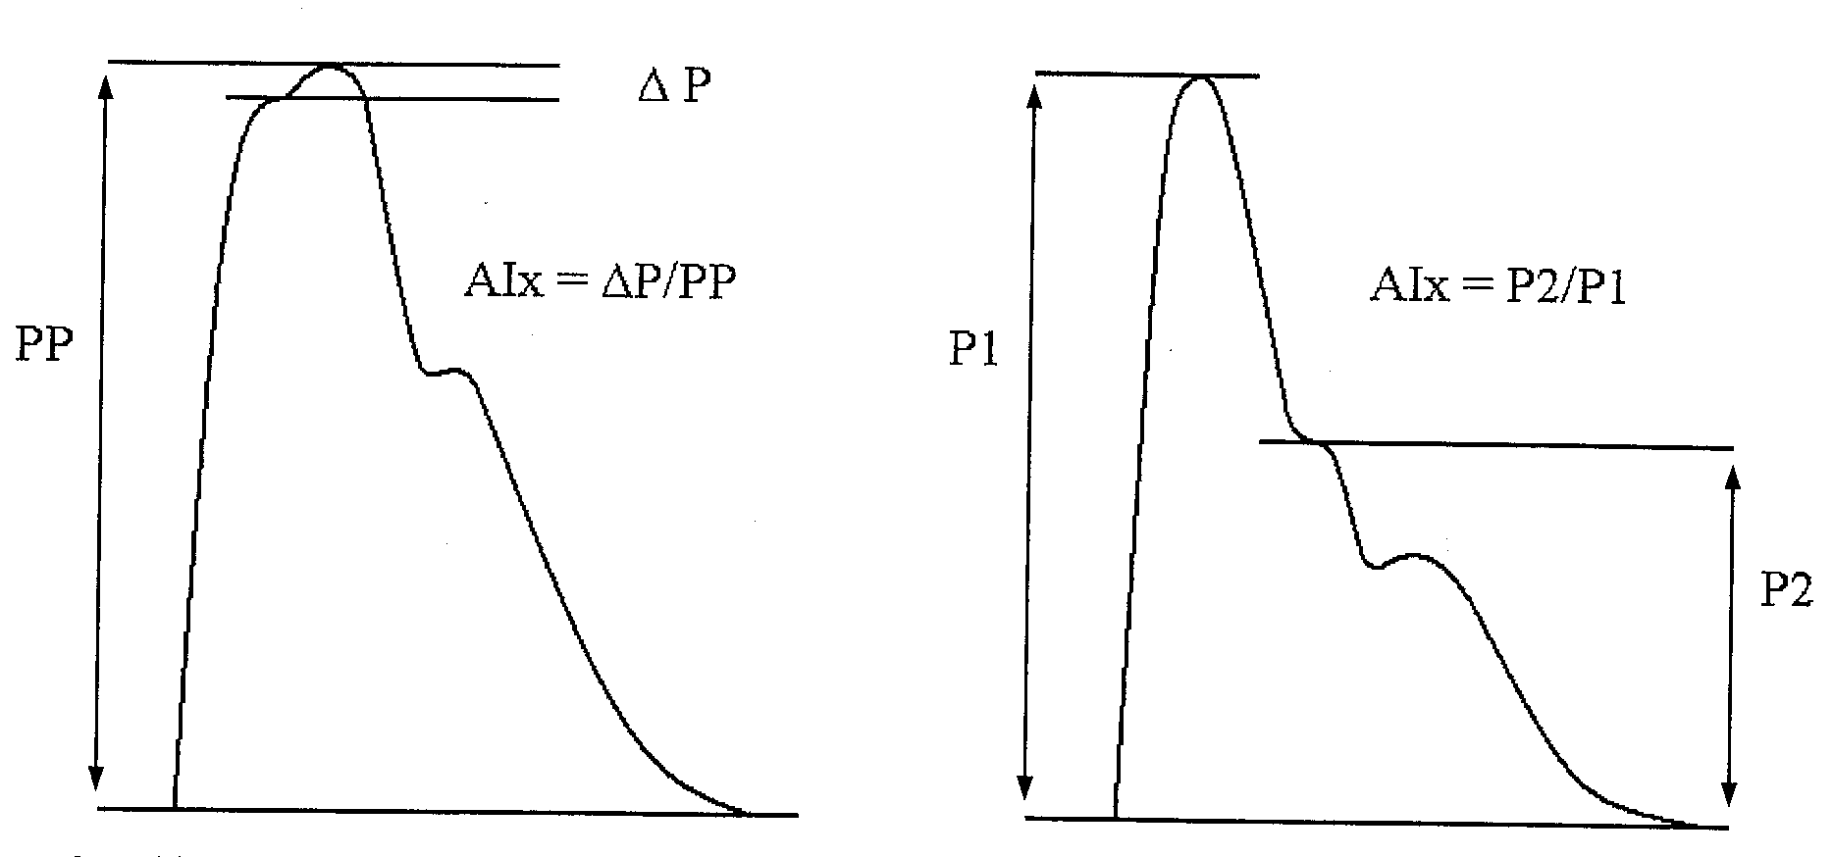
How can arterial structure properties help us…
Trying partially to answer

Slide 4
{
ELASTIC ARTERY
Intima
Media
{
Adventitia
{
Endothelium
Collagen
Smooth muscle cells
Vasa vasorum
Elastic laminae

Slide 5
How can arterial structure properties help us…
        Measurement of central BP has been suggested to hold greater prognostic capability than conventional brachial BP.
      Laurent S et al Stroke, 2003.
        African-Americans have diffuse macrovascular and microvascular dysfunction manifesting as increased stiffness (reduced compliance) of elastic central arteries, such as the carotid artery and aorta, heightened resistance artery constriction, and blunted resistance artery dilation.
      Heffernan KS , Am J Physiol Heart Circ Physiol, 2008.

Slide 6
Arterial structure and function: definitions and pathophysiology
Arterial stiffness
Pulse wave reflections
Pulse pressure
Intima media thickness
Endothelial function

Slide 7
determinants of blood pressure
BLOOD PRESSURE
static dynamic
mean arterial pressure pulse pressure
↓ ↓
resistance vessels capacitance vessels
↓ ↓
arterioles arteries

Slide 8
vessel wall properties
arterial compliance ≈ buffering capacity
C = ΔV/ΔP
arterial distensibility ≈ arterial stiffness
D = ΔV/V/ΔP
pulse wave velocity PWV= √1/(ρ.D)

Slide 9
arterial stiffness differs between vascular territories
MAP = CO x TPR
in large artery tree constant
PP ≈ SV/C
in large artery tree not constant

Slide 10
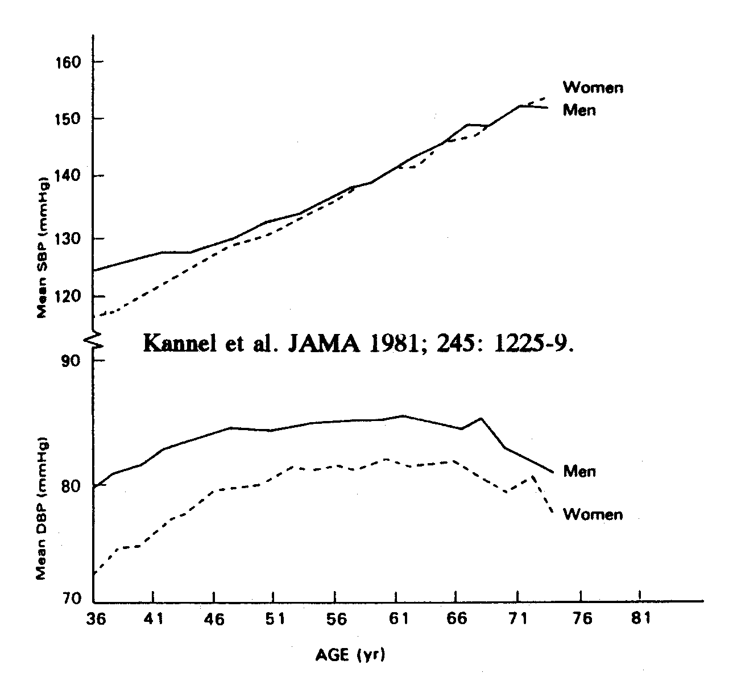
Blood pressure with ageing

Slide 11
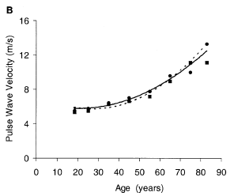
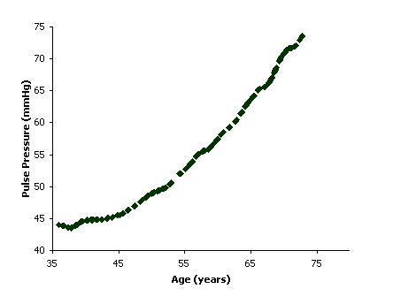
Effect of Age on
PWVao and brachial PP
McEniery 2005 Kannel 1981

Slide 12
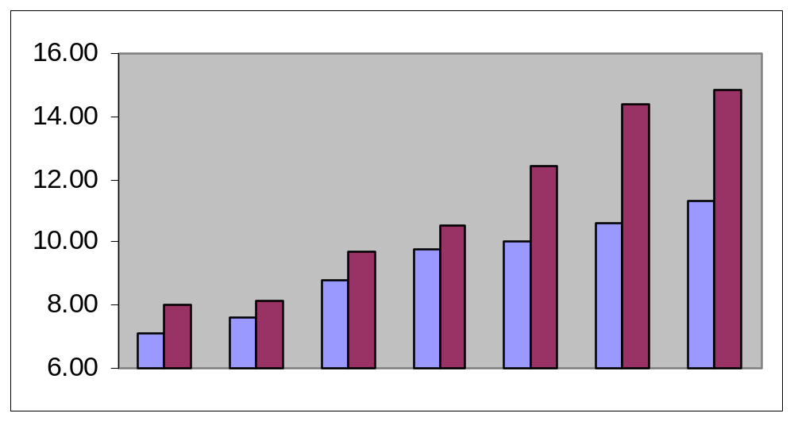
Pulse Wave Velocity in Caucasian and Black subjects
For 10 yrs age intervals
P<0.001 for trend
Pulse Wave Velocity (m/s)
15-19
20-29
30-39
40-49
50-59
60-69
70-79
yrs
Caucasians (n=206)
Blacks (n=121)
Muchanga B, Diogo D, Damasceno A, J Polonia. J Hypertens 2003; 21:S108

Slide 13
Determinants of arterial stiffness
Blood pressure (MAP)
Age
Gender
BMI
Pulse rate
Smoking
Alcohol intake
Vasoactive/Antihypertensive treatment
van der Heijden-Spek et al. Hypertension 2000; 35:637-642

Slide 14
Arterial stiffness an early sign of disease (risk)
age Van der Heyden et al. Hypertension 2000.
hypertension Laurent et al. J Hypertens 1993.
Diabetes I Kool et al. Diabetes Care 1995.
Diabetes II Schram et al. Hypertension 2004.
insulin resistance Giltay et al. Diabetologia 1999.
IGM Henry et al. Circulation 2003.
hypercholesterolemia Kool et al. Eur J Clin Pharmacol 1995.
smoking Kool et al. J Am Coll Cardiol 1993.
hyperhomocysteinemia Bortolotto et al. Hypertension 1999.

Slide 15
early wave reflections

Slide 16
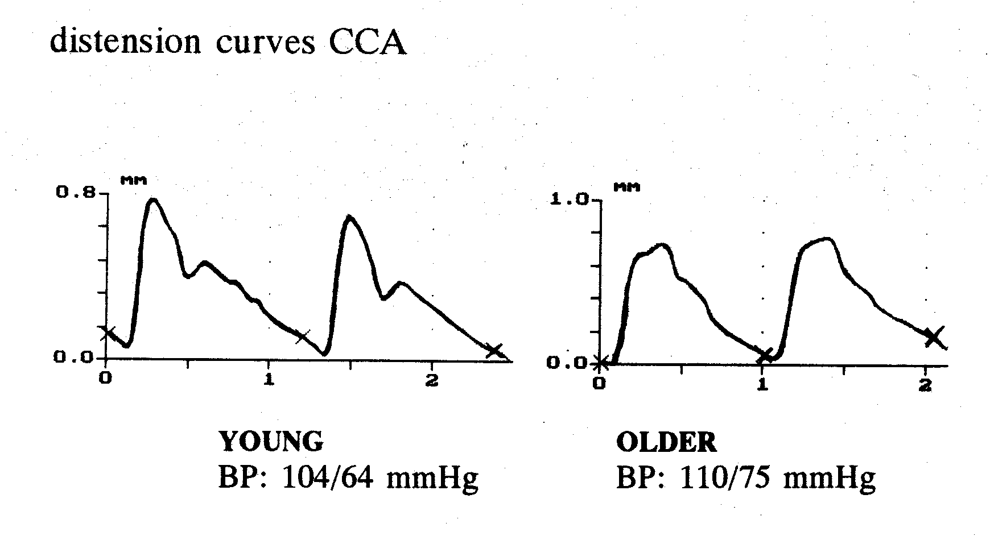
Arterial stiffness and early wave reflections

Slide 17
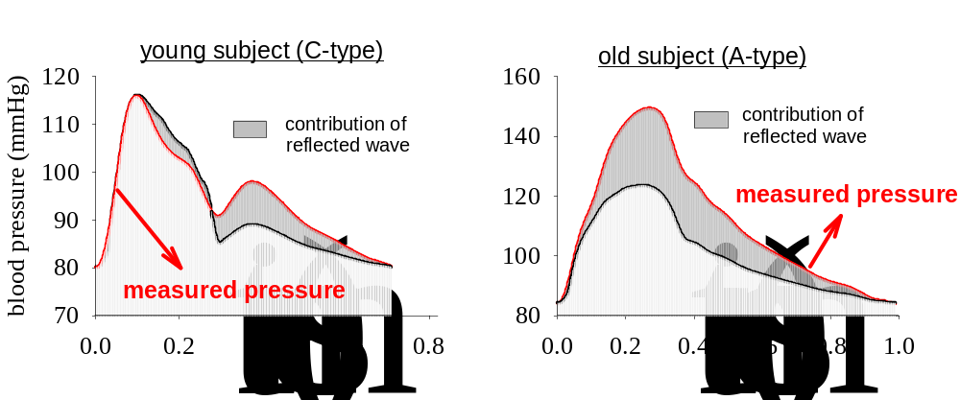
Why study wave reflections ?
explains patho-physiological changes in blood pressure
(early return of reflected wave: ‘boost’ of systolic pressure)
extra load on the heart
co-determinant of pulse pressure
risk assessment ?

Slide 18
Wave reflections
ΔP = augmented pressure (AP)
AIx = augmentation index (AP/PP)

Slide 19
Effect of early wave reflection
Determined by
arterial stiffness (PWV ↑)
reflection points (changes of impedance)
-functional (tone small arteries, TPR)
-structural arterial branching (height)
plaques …
other confounders: heart rate ….

Slide 20
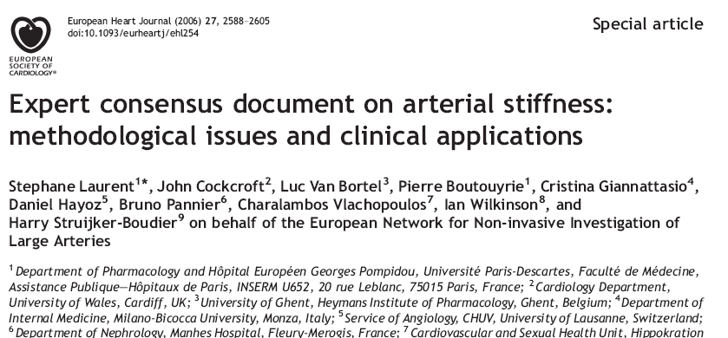
Assessment of arterial stiffness in the clinical assessment of patients. …

Slide 21
Assessment of arterial stiffness in the clinical assessment of patients. …
        In recent years, great emphasis has been placed on the role of arterial stiffness in the development of cardiovascular diseases and, the assessment of arterial stiffness is increasingly used in the clinical assessment of patients, (…) clinicians and researchers still report difficulties in selecting the most appropriate methodology for their specific use.
        This paper (…) is aimed at providing an updated and practical overview of the most relevant methodological aspects and clinical applications in this area.
        Laurent S, Cockcroft J, Van Bortel L et al, Eur Heart J. 2006

Slide 22
Arterial structure studies in Africa…
Challenges and opportunities
        Few publication and a little is known
        Opportunities exist with ongoing studies
         VITARAA Study (Home based BP control)
         NOAAH Study
         WHO STEPs country surveys : Arterial stiffness can be non-invasively assessed, and the measurements can be added in WHO STEPS Instrument , Optional measures section

Slide 23
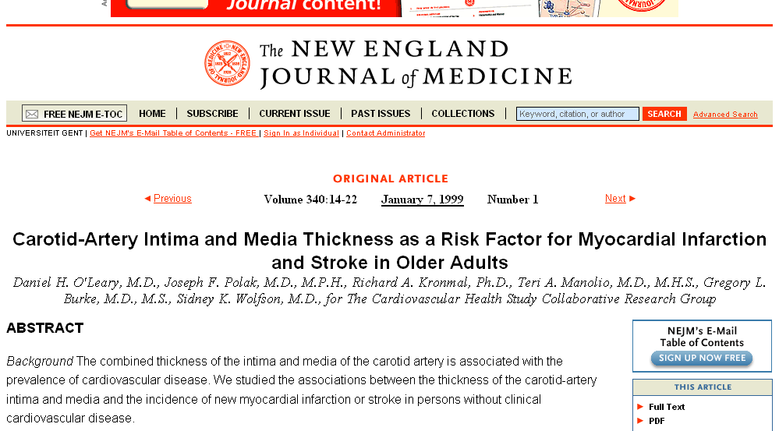
Arterial structure studies in Africa…
Challenges and opportunities
        Evidences of importance exist and arterial stiffness surrogates are already quoted in different guidlines elswhere.

Slide 24
Carotid IMT: associated with CHD
Salonen JT et al. Arterioscler Thromb 1991
Adams et al. Circulation 1995
Bots ML et al. Circulation 1997
Chambless LE et al. Am J Epidemiol 1997
Hodis HN et al. Ann Intern Med 1998
O’Leary DH et al. N Engl J Med 1999
indicator of generalized atherosclerosis

Slide 25
Arterial structure studies in Africa…
Challenges and opportunities
        Arterial stiffness surrogates should be included in coming guidelines for management of hypertension in Africa

